Slide 1
Data Mining
Practical Machine Learning Tools and Techniques
Slides for Chapter 8 of Data Mining by I. H. Witten, E. Frank and
M. A. Hall

Slide 2
Ensemble learning
Combining multiple models
  The basic idea
Bagging
  Bias-variance decomposition, bagging with costs
Randomization
  Rotation forests
Boosting
  AdaBoost, the power of boosting
Additive regression
  Numeric prediction, additive logistic regression
Interpretable ensembles
  Option trees, alternating decision trees, logistic model trees
Stacking

Slide 3
Combining multiple models
Basic idea:
build different “experts”, let them vote
Advantage:
  often improves predictive performance
Disadvantage:
  usually produces output that is very hard to analyze
  but: there are approaches that aim to produce a single comprehensible structure

Slide 4
Bagging
Combining predictions by voting/averaging
  Simplest way
  Each model receives equal weight
“Idealized” version:
  Sample several training sets of size n
  (instead of just having one training set of size n)
  Build a classifier for each training set
  Combine the classifiers’ predictions
Learning scheme is unstable ⇒
almost always improves performance
  Small change in training data can make big change in model (e.g. decision trees)

Slide 5
Bias-variance decomposition
Used to analyze how much selection of any specific training set affects performance
Assume infinitely many classifiers,
built from different training sets of size n
For any learning scheme,
  Bias = expected error of the combined
  classifier on new data
  Variance = expected error due to the
  particular training set used
Total expected error ≈ bias + variance

Slide 6
More on bagging
Bagging works because it reduces variance by voting/averaging
  Note: in some pathological hypothetical situations the overall error might increase
  Usually, the more classifiers the better
Problem: we only have one dataset!
Solution: generate new ones of size n by sampling from it with replacement
Can help a lot if data is noisy
Can also be applied to numeric prediction
  Aside: bias-variance decomposition originally only known for numeric prediction

Slide 7
Bagging classifiers
Model generation
Let n be the number of instances in the training data
For each of t iterations:
Sample n instances from training set
(with replacement)
Apply learning algorithm to the sample
Store resulting model
Classification
For each of the t models:
Predict class of instance using model
Return class that is predicted most often

Slide 8
Bagging with costs
Bagging unpruned decision trees known to produce good probability estimates
  Where, instead of voting, the individual classifiers' probability estimates are averaged
  Note: this can also improve the success rate
Can use this with minimum-expected cost approach for learning problems with costs
Problem: not interpretable
  MetaCost re-labels training data using bagging with costs and then builds single tree

Slide 9
Randomization
Can randomize learning algorithm instead of input
Some algorithms already have a random component: eg. initial weights in neural net
Most algorithms can be randomized, eg. greedy algorithms:
  Pick from the N best options at random instead of always picking the best options
  Eg.: attribute selection in decision trees
More generally applicable than bagging: e.g. random subsets in nearest-neighbor scheme
Can be combined with bagging

Slide 10
Rotation forests
Bagging creates ensembles of accurate classifiers with relatively low diversity
  Bootstrap sampling creates training sets with a distribution that resembles the original data
Randomness in the learning algorithm increases diversity but sacrifices accuracy of individual ensemble members
Rotation forests have the goal of creating accurate and diverse ensemble members

Slide 11
Rotation forests
Combine random attribute sets, bagging and principal components to generate an ensemble of decision trees
An iteration involves
  Randomly dividing the input attributes into k disjoint subsets
  Applying PCA to each of the k subsets in turn
  Learning a decision tree from the k sets of PCA directions
Further increases in diversity can be achieved by creating a bootstrap sample in each iteration before applying PCA

Slide 12
Boosting
Also uses voting/averaging
Weights models according to performance
Iterative: new models are influenced by performance of previously built ones
  Encourage new model to become an “expert” for instances misclassified by earlier models
  Intuitive justification: models should be experts that complement each other
Several variants

Slide 13
AdaBoost.M1
Model generation
Assign equal weight to each training instance
For t iterations:
Apply learning algorithm to weighted dataset,
store resulting model
Compute model’s error e on weighted dataset
If e = 0 or e ≥ 0.5:
Terminate model generation
For each instance in dataset:
If classified correctly by model:
Multiply instance’s weight by e/(1-e)
Normalize weight of all instances
Classification
Assign weight = 0 to all classes
For each of the t (or less) models:
For the class this model predicts
add –log e/(1-e) to this class’s weight
Return class with highest weight

Slide 14
More on boosting I
Boosting needs weights … but
Can adapt learning algorithm ... or
Can apply boosting without weights
  resample with probability determined by weights
  disadvantage: not all instances are used
  advantage: if error > 0.5, can resample again
Stems from computational learning theory
Theoretical result:
  training error decreases exponentially
Also:
  works if base classifiers are not too complex, and
  their error doesn’t become too large too quickly

Slide 15
More on boosting II
Continue boosting after training error = 0?
Puzzling fact:
generalization error continues to decrease!
  Seems to contradict Occam’s Razor
Explanation:
consider margin (confidence), not error
  Difference between estimated probability for true class and nearest other class (between –1 and 1)
Boosting works with weak learners
only condition: error doesn’t exceed 0.5
In practice, boosting sometimes overfits (in contrast to bagging)

Slide 16
Additive regression I
Turns out that boosting is a greedy algorithm for fitting additive models
More specifically, implements forward stagewise additive modeling
Same kind of algorithm for numeric prediction:
  Build standard regression model (eg. tree)
  Gather residuals, learn model predicting residuals (eg. tree), and repeat
To predict, simply sum up individual predictions from all models

Slide 17
Additive regression II
Minimizes squared error of ensemble if base learner minimizes squared error
Doesn't make sense to use it with standard multiple linear regression, why?
Can use it with simple linear regression to build multiple linear regression model
Use cross-validation to decide when to stop
Another trick: shrink predictions of the base models by multiplying with pos. constant < 1
  Caveat: need to start with model 0 that predicts the mean

Slide 18
Additive logistic regression
Can use the logit transformation to get algorithm for classification
  More precisely, class probability estimation
  Probability estimation problem is transformed into regression problem
  Regression scheme is used as base learner (eg. regression tree learner)
Can use forward stagewise algorithm: at each stage, add model that maximizes probability of data
If fj is the jth regression model, the ensemble predicts probability for the first class

Slide 19
LogitBoost
Model generation
For j = 1 to t iterations:
For each instance a[i]:
Set the target value for the regression to
z[i] = (y[i] – p(1|a[i])) / [p(1|a[i]) × (1-p(1|a[i])]
Set the weight of instance a[i] to p(1|a[i]) × (1-p(1|a[i])
Fit a regression model f[j] to the data with class
values z[i] and weights w[i]
Classification
Predict 1st class if p(1 | a) > 0.5, otherwise predict 2nd class
Maximizes probability if base learner minimizes squared error
Difference to AdaBoost: optimizes probability/likelihood instead of exponential loss
Can be adapted to multi-class problems
Shrinking and cross-validation-based selection apply

Slide 20
Option trees
Ensembles are not interpretable
Can we generate a single model?
  One possibility: “cloning” the ensemble by using lots of artificial data that is labeled by ensemble
  Another possibility: generating a single structure that represents ensemble in compact fashion
Option tree: decision tree with option nodes
  Idea: follow all possible branches at option node
  Predictions from different branches are merged using voting or by averaging probability estimates

Slide 21
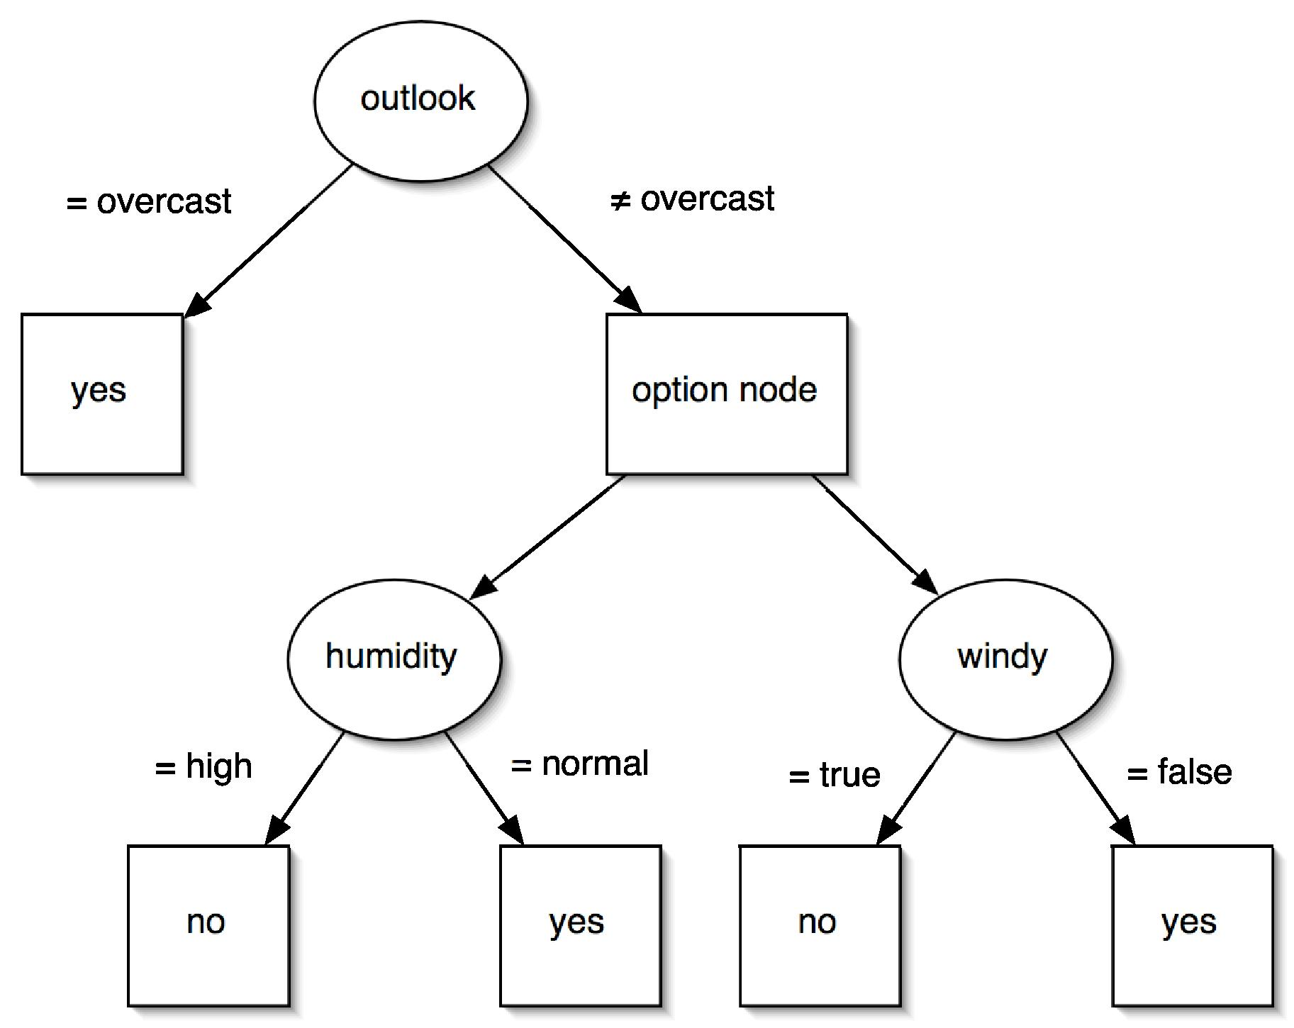
Example
Can be learned by modifying tree learner:
  Create option node if there are several equally promising splits (within user-specified interval)
  When pruning, error at option node is average error of options

Slide 22
Alternating decision trees
Can also grow option tree by incrementally adding nodes to it
Structure called alternating decision tree, with splitter nodes and prediction nodes
  Prediction nodes are leaves if no splitter nodes have been added to them yet
  Standard alternating tree applies to 2-class problems
  To obtain prediction, filter instance down all applicable branches and sum predictions
    Predict one class or the other depending on whether the sum is positive or negative

Slide 23
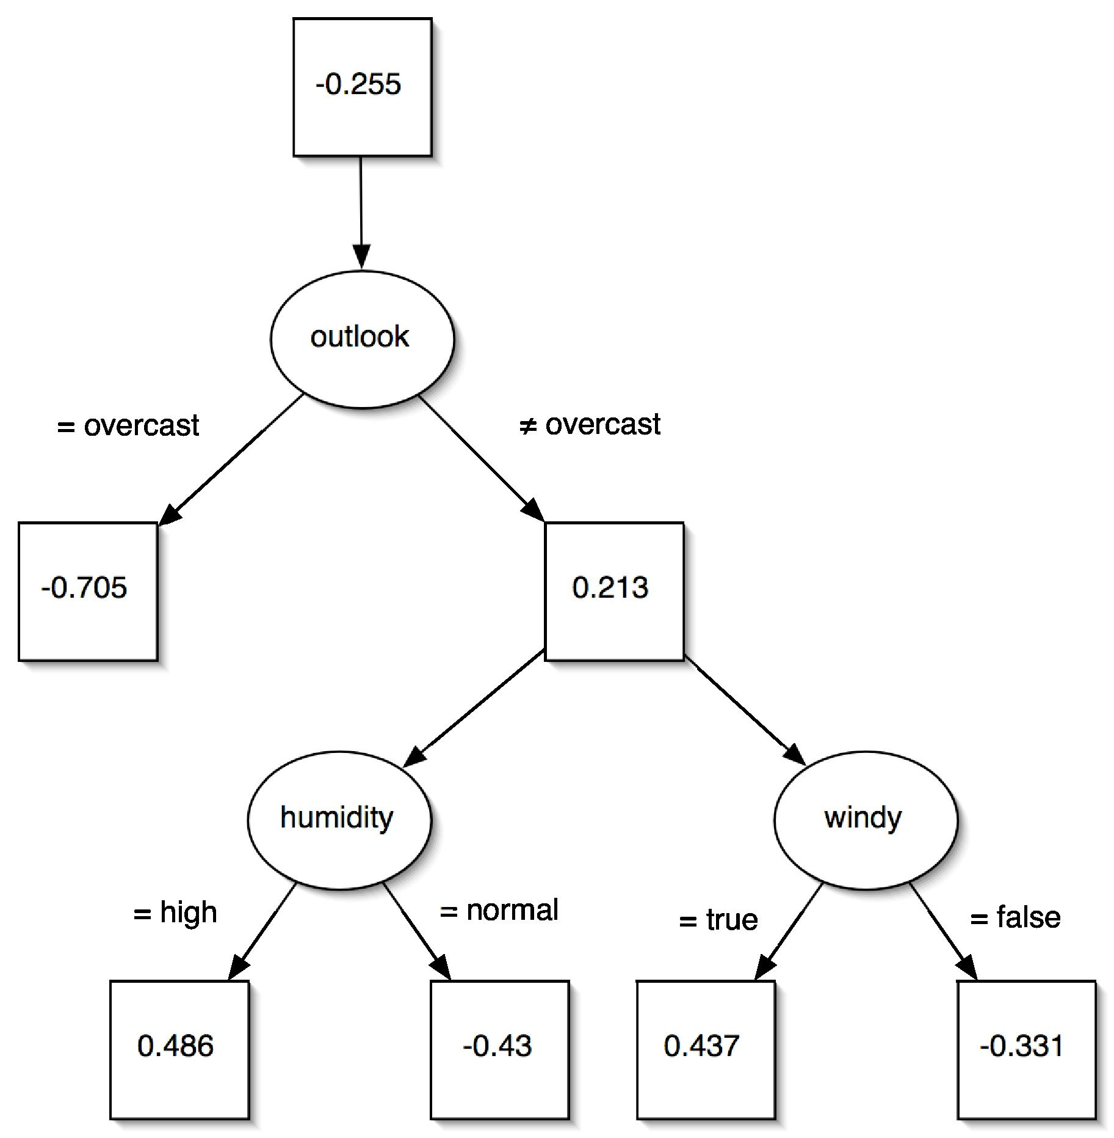
Example

Slide 24
Growing alternating trees
Tree is grown using a boosting algorithm
  Eg. LogitBoost described earlier
  Assume that base learner produces single conjunctive rule in each boosting iteration (note: rule for regression)
  Each rule could simply be added into the tree, including the numeric prediction obtained from the rule
  Problem: tree would grow very large very quickly
  Solution: base learner should only consider candidate rules that extend existing branches
    Extension adds splitter node and two prediction nodes (assuming binary splits)
  Standard algorithm chooses best extension among all possible extensions applicable to tree
  More efficient heuristics can be employed instead

Slide 25
Logistic model trees
Option trees may still be difficult to interpret
Can also use boosting to build decision trees with linear models at the leaves (ie. trees without options)
Algorithm for building logistic model trees:
  Run LogitBoost with simple linear regression as base learner (choosing the best attribute in each iteration)
  Interrupt boosting when cross-validated performance of additive model no longer increases
  Split data (eg. as in C4.5) and resume boosting in subsets of data
  Prune tree using cross-validation-based pruning strategy (from CART tree learner)

Slide 26
Stacking
To combine predictions of base learners, don’t vote, use meta learner
  Base learners: level-0 models
  Meta learner: level-1 model
  Predictions of base learners are input to meta learner
Base learners are usually different schemes
Can’t use predictions on training data to generate data for level-1 model!
  Instead use cross-validation-like scheme
Hard to analyze theoretically: “black magic”

Slide 27
More on stacking
If base learners can output probabilities, use those as input to meta learner instead
Which algorithm to use for meta learner?
  In principle, any learning scheme
  Prefer “relatively global, smooth” model
    Base learners do most of the work
    Reduces risk of overfitting
Stacking can be applied to numeric prediction too

